Slide 1
Development of a Knowledge Graph for the Canadian Milk-recording Industry

Slide 2
Outline
01
Some statistic of the models
Origin data format
Number of instances
Accuracy
02
The pipeline
Question Answering
Regular Expression
Replace components

Slide 3
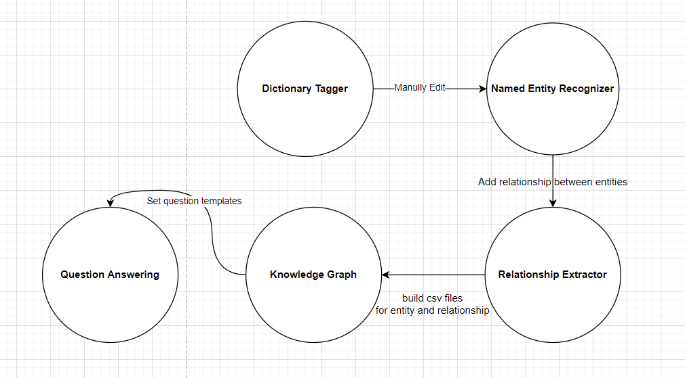
Method one: Building KG in an automatic format by training two models
Scripts: To fast tag the phase from the text
Neural Model: Bi-Long Short Term Memory
To find the phase from the text
Scripts: Map natural query into Database query language to retrieve the answer from the database
Store the entity-relation-entity in a Graph Database: neo4j
Neural Model: BERT (a state-of-art NLP model)
To classify relationship find in sentences for entity-entity pair

Slide 4
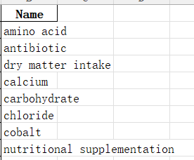
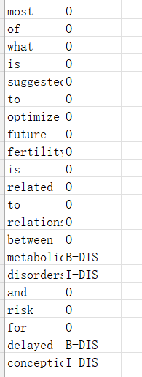
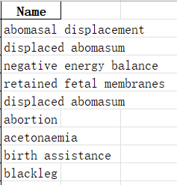
Dictionary tagger:
Nutrition Dictionary: 105 words
B-NUT
I-NUT
B-DIS
I-DIS
O
{
{
Disease Dictionary: 71 words
Input:
Output:
Raw Corpus: 10 papers

Slide 5
Outline
01
Some statistic of the models
Named Entity Recognition:
02
The pipeline
Question Answering
Regular Expression
Replace components

Slide 6
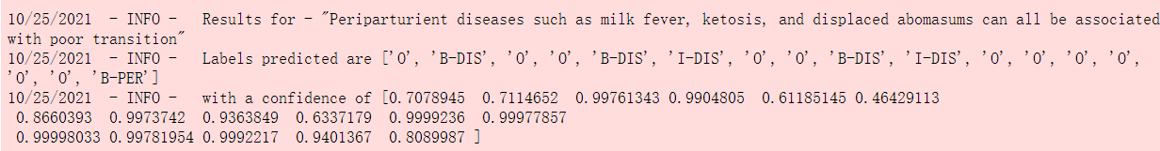
Named Entity Recognition:
{
Prediction:
{
Training:

Slide 7
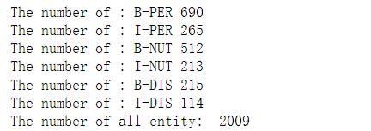
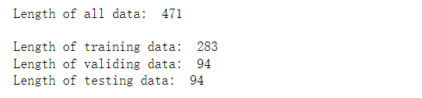
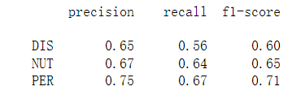
Named Entity Recognition: Details and fine-tuning
1, Number of entities from 10 papers
2, Number of sentences for train, valid and test set (3: 1: 1)
Randomly Shuffled
and split by sentence
3, Current accuracy
Following steps: Tag and train another 10 papers, tune the model, training with all data

Slide 8
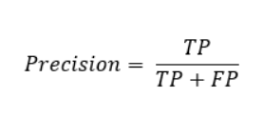
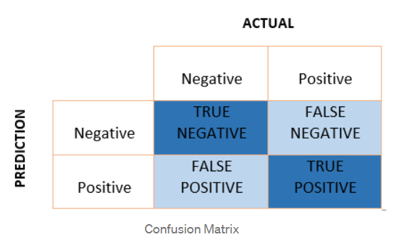
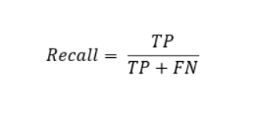
Named Entity Recognition: Details and fine-tuning
Why do I choice this metric from confusion matrix?
For all words predicted as entities,
what percentage is actual entities?
For all words that are actual entity,
what percentage is predicted?

Slide 9
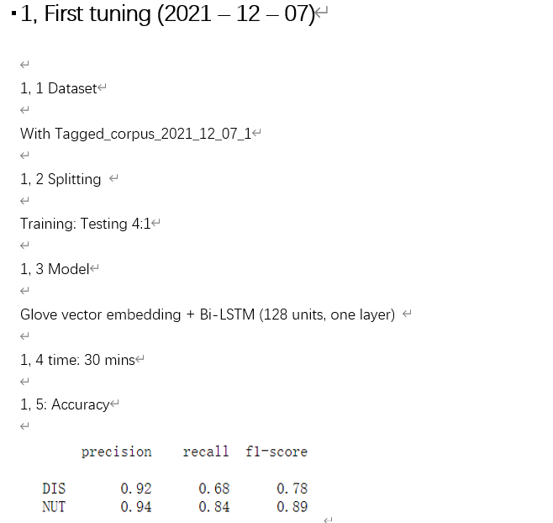
Named Entity Recognition: Details and fine-tuning
3 mins on GPU

Slide 10
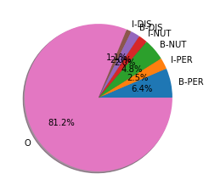
Named Entity Recognition: Details and fine-tuning
Distribution of the entities:
Hope the percentage of entities could be large and their distribution could be more normal, which would be better for training
Following steps: Tag and train another 10 papers, tune the model, training with all data

Slide 11
Outline
01
Some statistic of the models
Relation Recognition Model
02
The pipeline
Question Answering
Regular Expression
Replace components

Slide 12
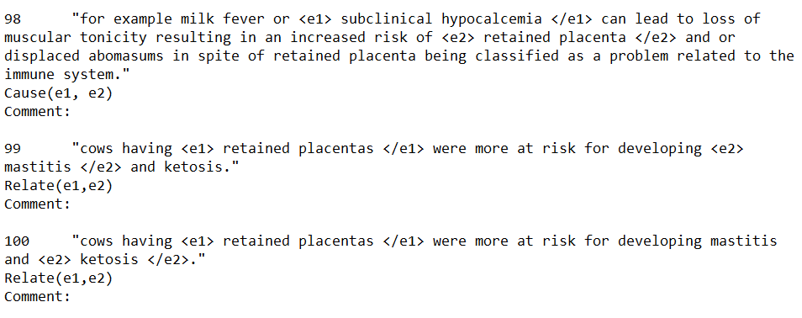
Relation Extraction Model: Data Format
An example of sentence format:
TEXT:
ENTITY1
Relationship:
ENTITY2

Slide 13
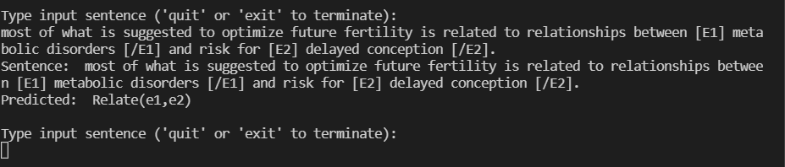
Relation Recognition Model
{
Training:
Prevent
Cause
Relate
Other
Prediction:
{

Slide 14
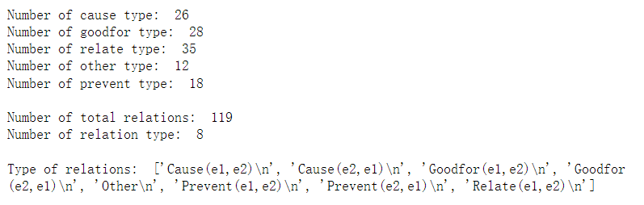
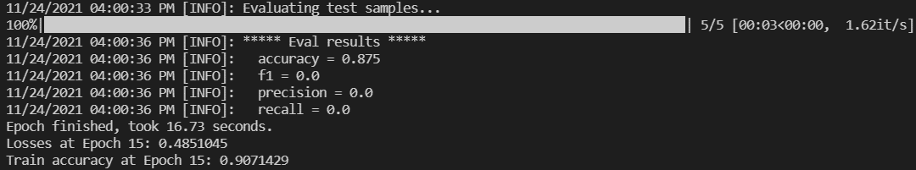
Relation Recognition Model
1, Statistic of the all dataset:
2, Split and train (2:1)
Training: 80 sentences
Test: 40 sentences
3, Accuracy:
On rephased test set
On unseen test set

Slide 15
Relation Extraction Model
Why so low?
1, Origin Dataset: SemEval2010_task8 (with 8000 training sentences, while mine has 80)
2, Too little data so the entities in the test set is not seen.

Slide 16
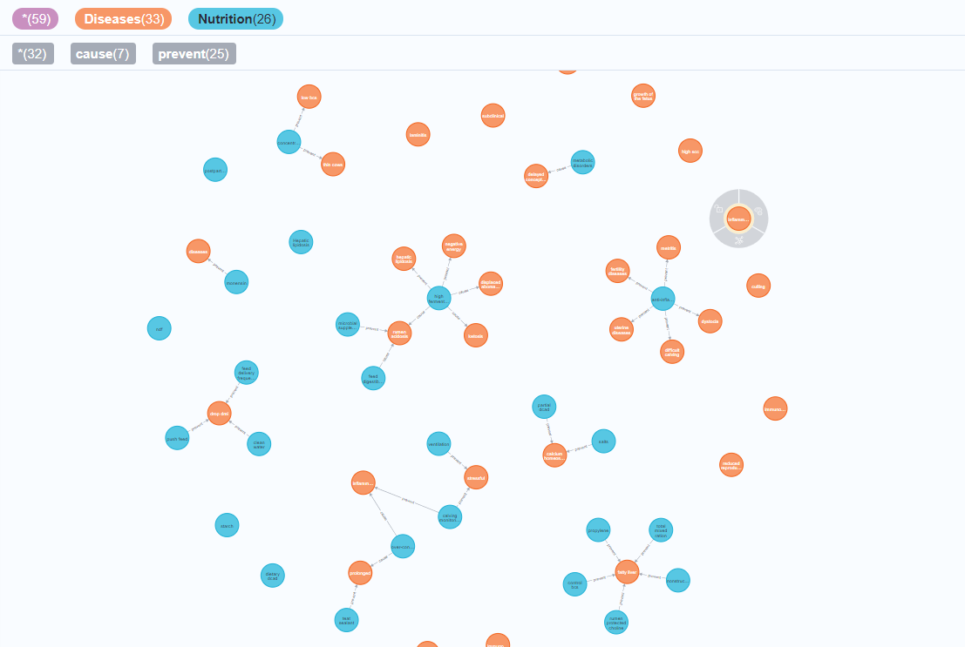
KG from the method one

Slide 17
Outline
01
Some statistic of the models
Origin data format
Number of instances
Accuracy
02
The Second pipeline
Question Answering
Regular Expression
Replace components

Slide 18
Method Two
Named Entity Recognition
Dictionary Tagger
Prediction from large bio-medical model
Tag hard-to-recognize entities
Could replace with mine NER
Prediction from large bio-medical model
Still mapping question
Still neo4j database
Tackled scare data problem by few-shot learning

Slide 19
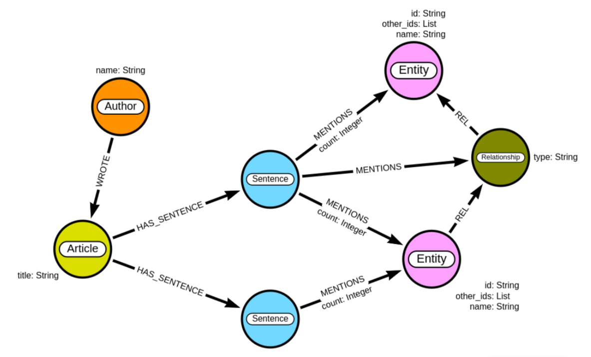
Method 2: Data Schema

Slide 20
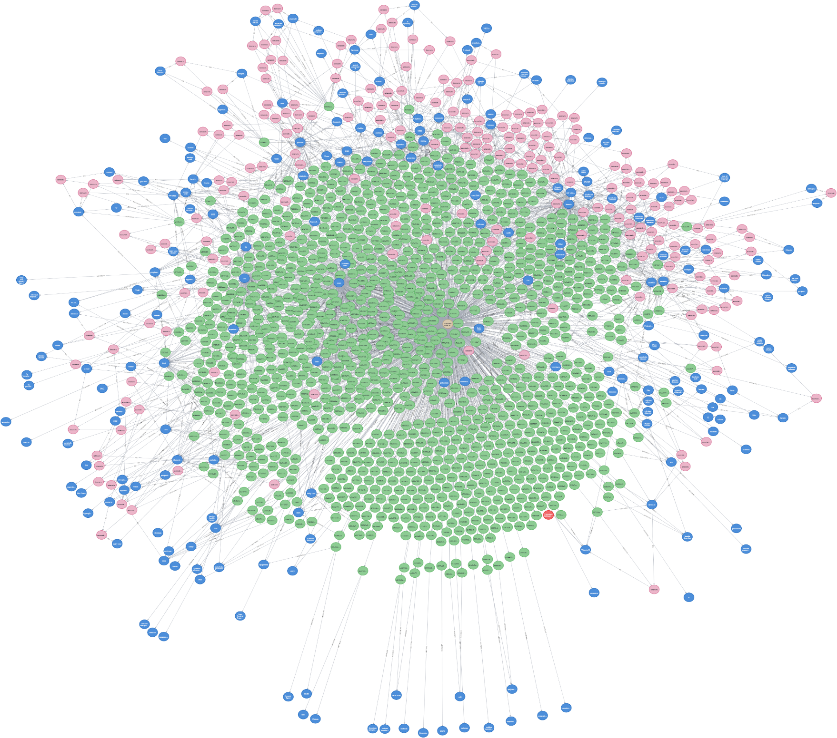
Knowledge Graph
From roughly 20 papers
Relation extraction confidence of 85

Slide 21
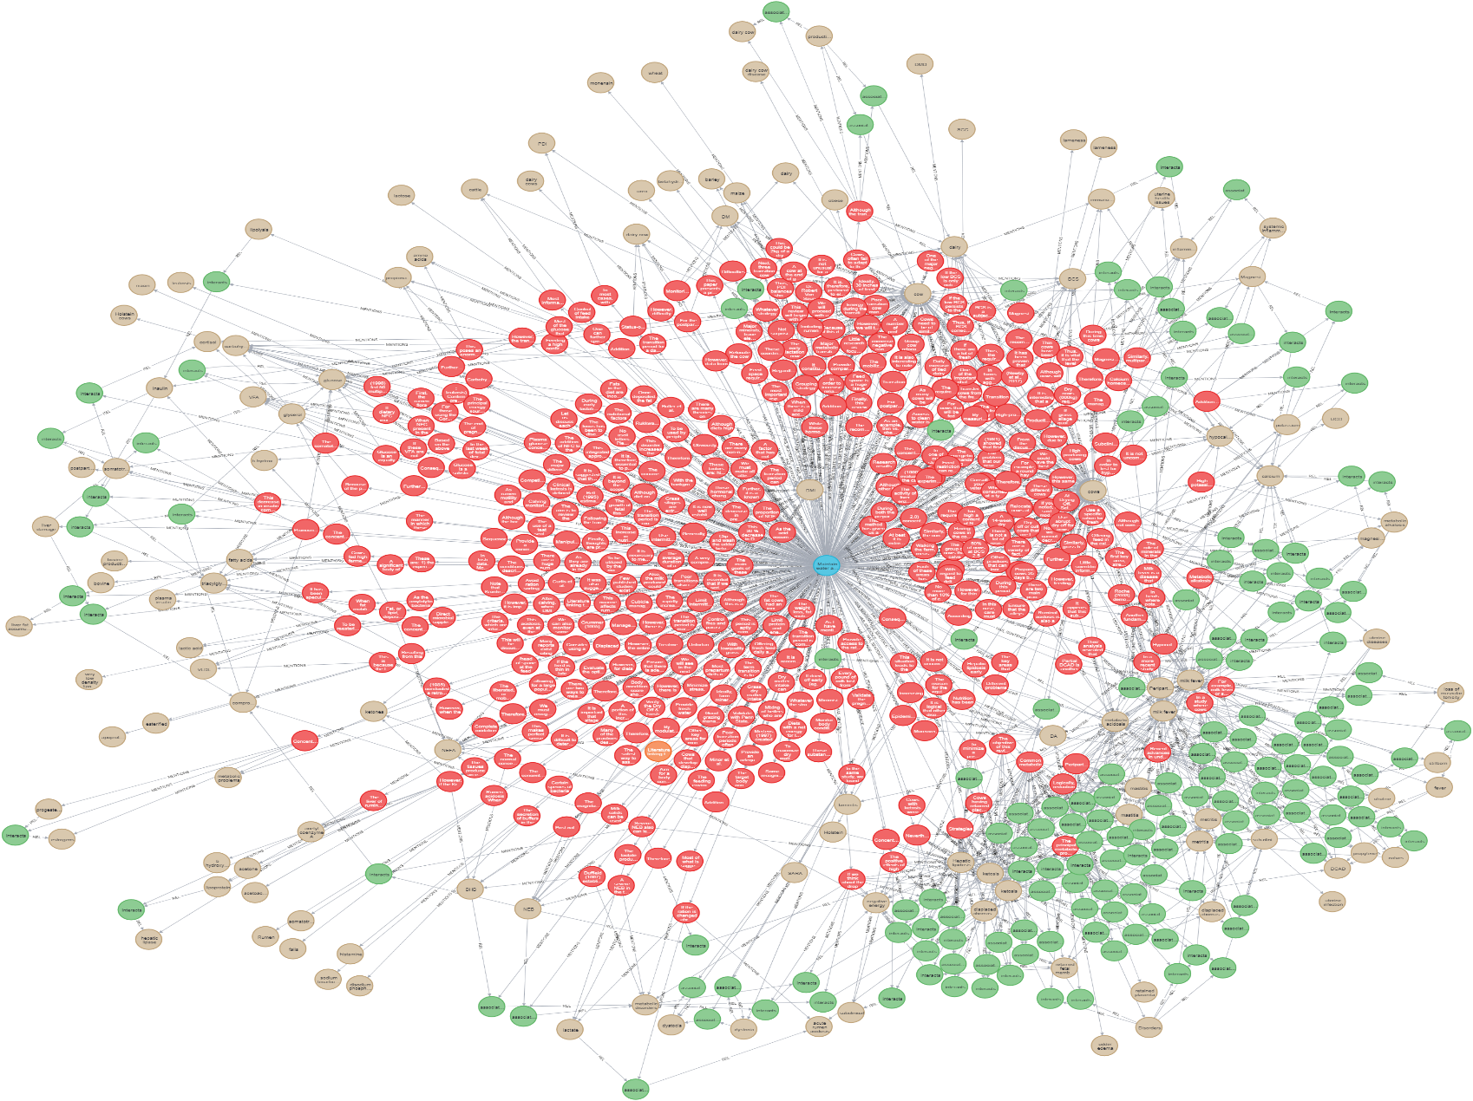
Knowledge Graph
From roughly 10 papers
Relation extraction confidence of 70

Slide 22
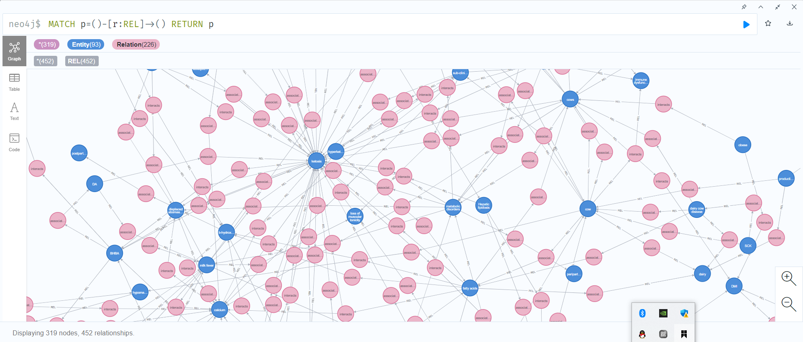
Method 2: Number of entities and relationships

Slide 23
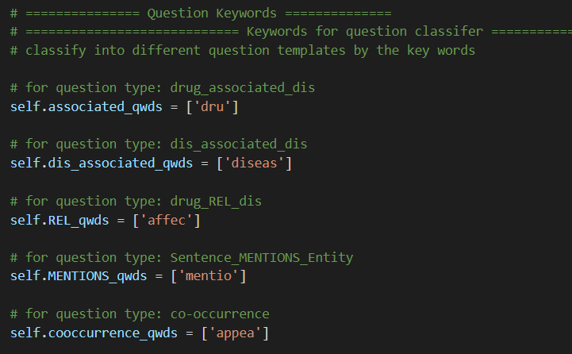
Method 2: Regular Expression (String matching)
Which will be used more

Slide 24

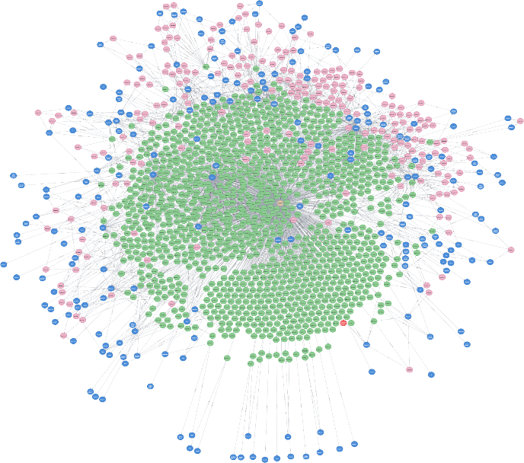
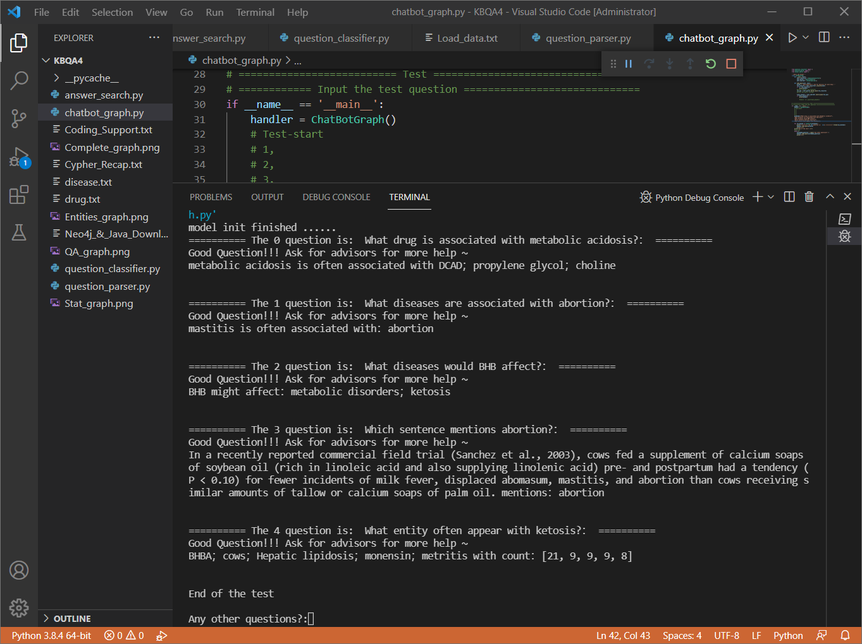
Method 2: Question Answering
Input: 20 Raw papers
Question Answering:

Slide 25
Method 2: QA
General Questions by templates:
Trace back:
Co-occurrence analysis:
Co-occurrence analysis discovered lots of new medicine for medical research

Slide 26
Thank you

Slide 27
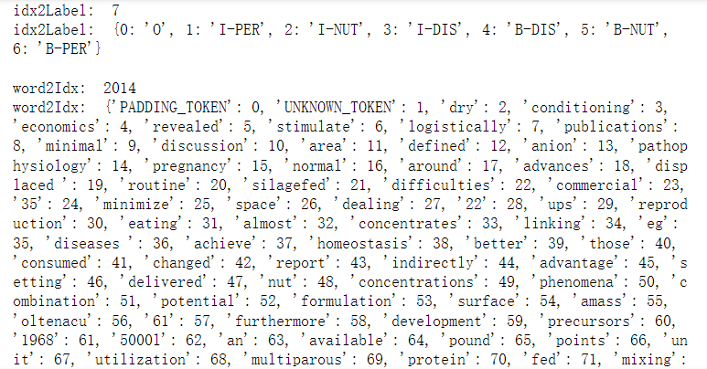
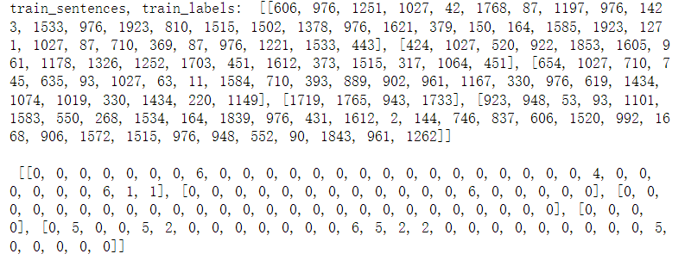
Neural Model one input
Create tokens
Assign tokens

Slide 28
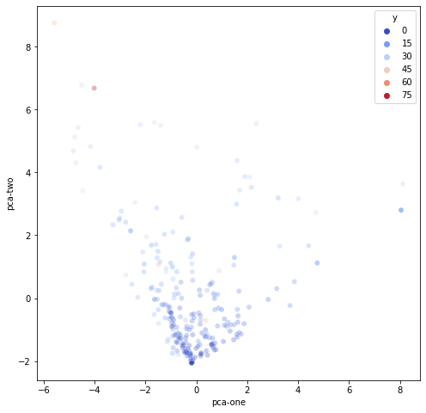
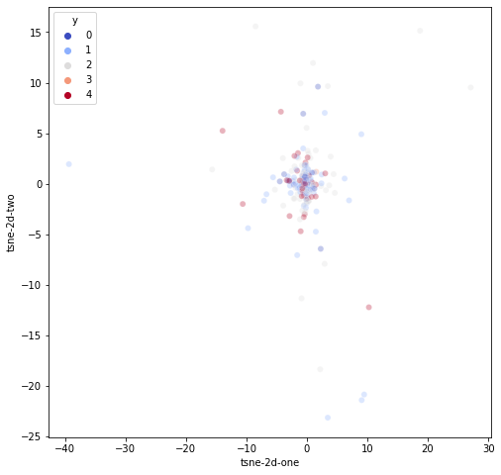
Neural Model one input visualization
PCA plot
t-SNE

Slide 29
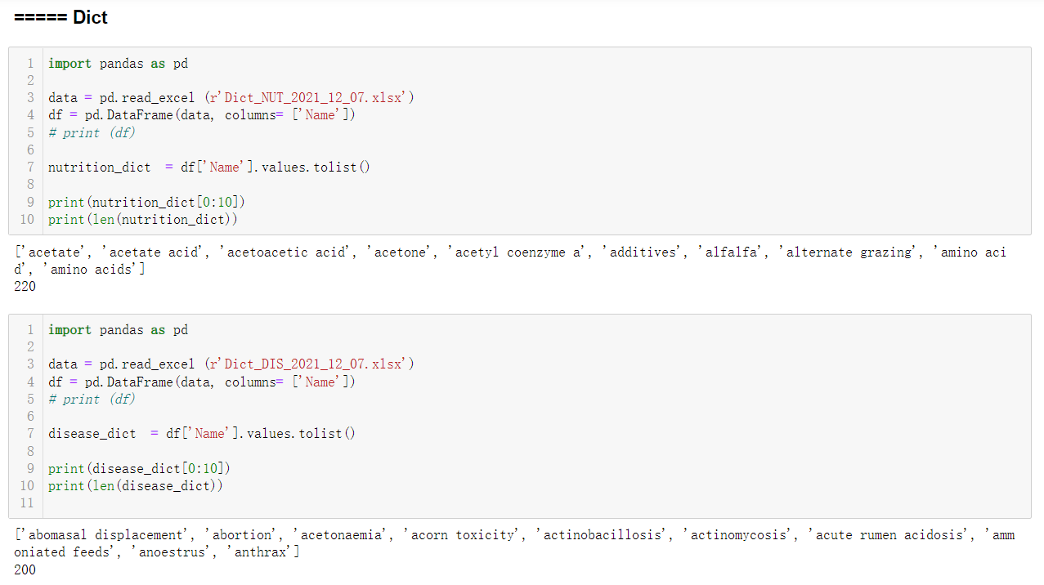
Updated dictionary

Slide 30
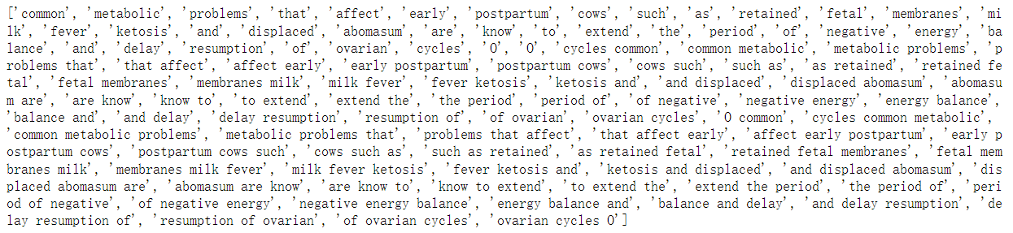
Dictionary Tagger
1, Split
2, Exact match with dictionary
3, Assign labels

Slide 31
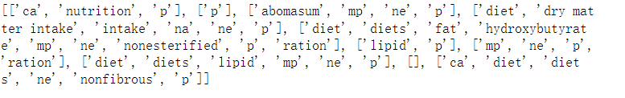
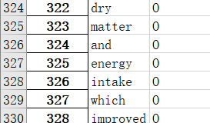
Dictionary Tagger
1, Why not match dictionary with sentences
2, Why don’t just use dictionary tagger

